Slide 1
Data Analysis for starting a new restaurant in California
Capstone Project - The Battle of Neighborhoods
IBM Applied Data Science Capstone
Varun Kumar Anand
30-Dec-2020

Slide 2
Introduction
California is the most populous U.S. state and the third-largest by area and is also the world's thirty-fourth most populous subnational entity.
California's economy, with a gross state product of $3.0 trillion, is the largest sub-national economy in the world.
California integrates foods, languages, and traditions from other areas across the country and around the globe.
California's agriculture industry has the highest output of any U.S. state.

Slide 3
Problem
To Provide locations in California for staring a new Restaurant which are more likely to give a good business.

Slide 4
Data Acquisition
Data Sources
Data was extracted from “California demographics by Cubit” Webpage using web scraping with BeautifulSoup.
GeoPy was used for calculating Latitude and Longitude for these Cities
Foursquare API was used for getting Venue data for these cities.

Slide 5
Libraries Used
Pandas – For Data Analysis
Json – For handling json files
Geopy – For converting address into Latitude and Longitude
sklearn.cluster - for Kmeans Clustering
folium – For Maps rendering
BeautifulSoup - For parsing HTML and XML files
Numpy – For Numerical analysis
Matplotlib – Python plotting module

Slide 6
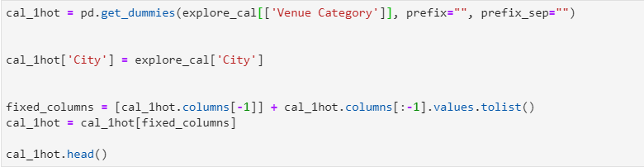
Methodology
Feature Extraction
One Hot Encoding

Slide 7
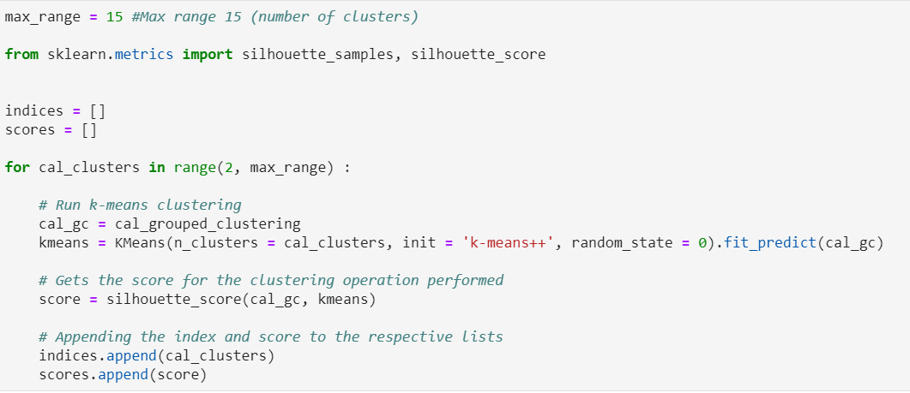
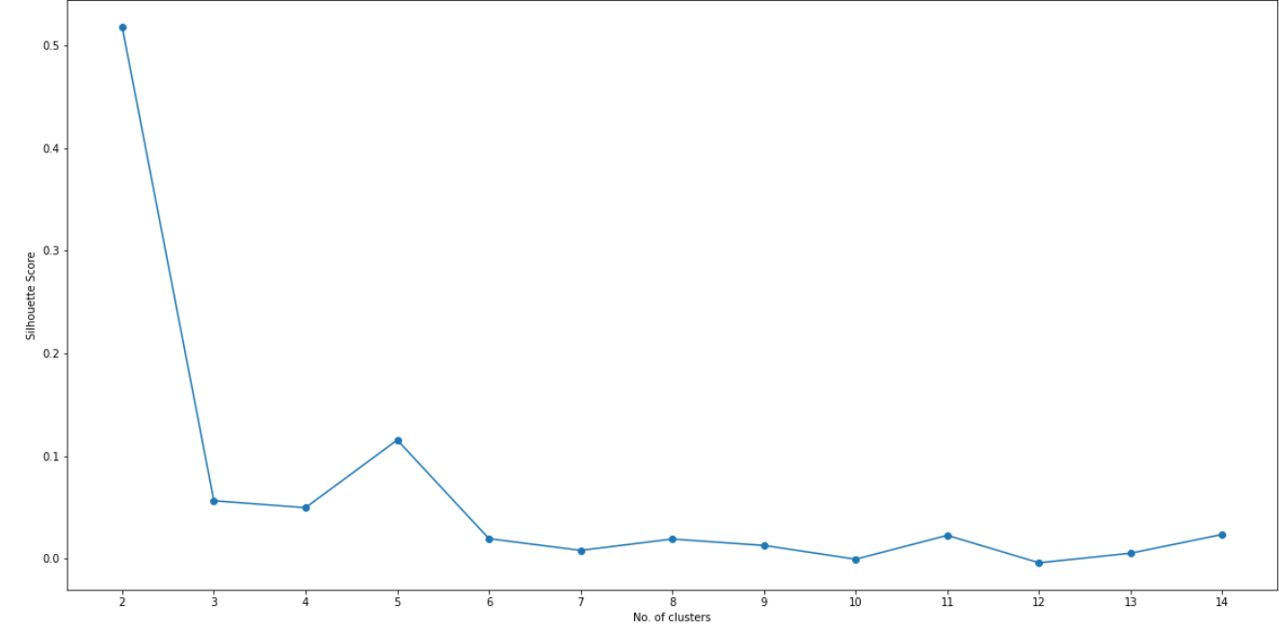
Methodology - Cont.
Unsupervised Learning- K-Means

Slide 8
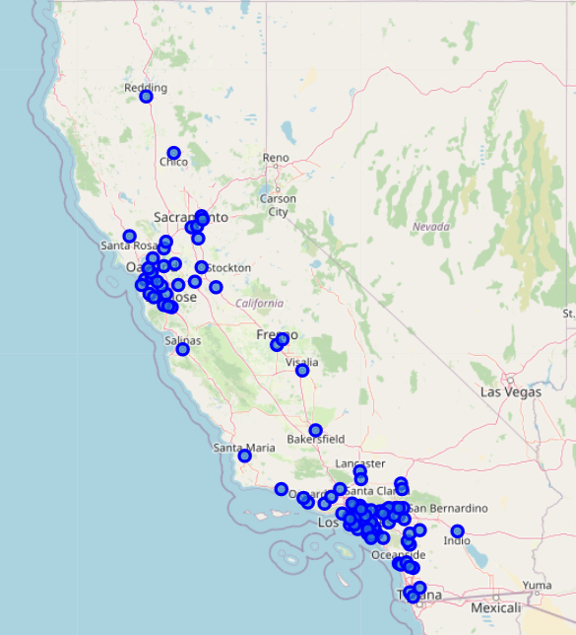
Methodology - Cont.
Plotting

Slide 9
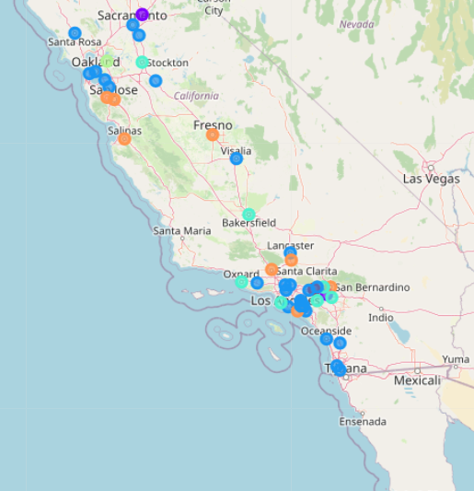
Results
Visualization of Clusters

Slide 10
Discussion
Cluster 3 contains most suitable cities for opening new restaurants.
Cluster 4 has a greater concentration of Mexican Restaurants.
Based on the Cuisine of the new Restaurant proper location can be selected from Cluster 3 and 4.
Prices and other variables are excluded from this study.
Improvements can be made with paid/premium account of foursquare where Ratings and Reviews can also be taken into account.

Slide 11
Conclusion
Machine Learning is very helpful in solving Business problems provided data is accurate.
Python’s inbuilt libraries are very helpful for applying machine learning technique and Data analysis.
This project can be re-used for other states also provided data is available in Foursquare API

Slide 12
Conclusion
Pth

